Slide 1
Best of PSYCH FORUM 2016: Schizophrenia: Preventing Deterioration and Returning to Baseline
Henry A. Nasrallah, MD
Sydney W. Souers Professor
Chair, Department of Psychiatry and Behavioral Neuroscience
Saint Louis University School of Medicine
St. Louis, MO

Slide 3
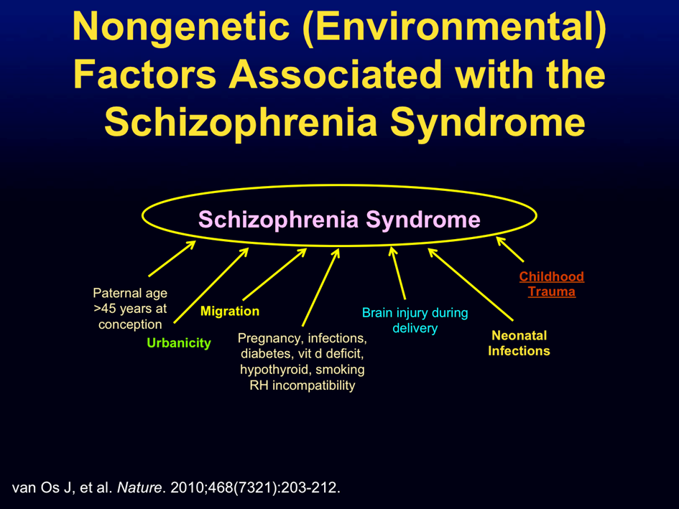

Slide 5
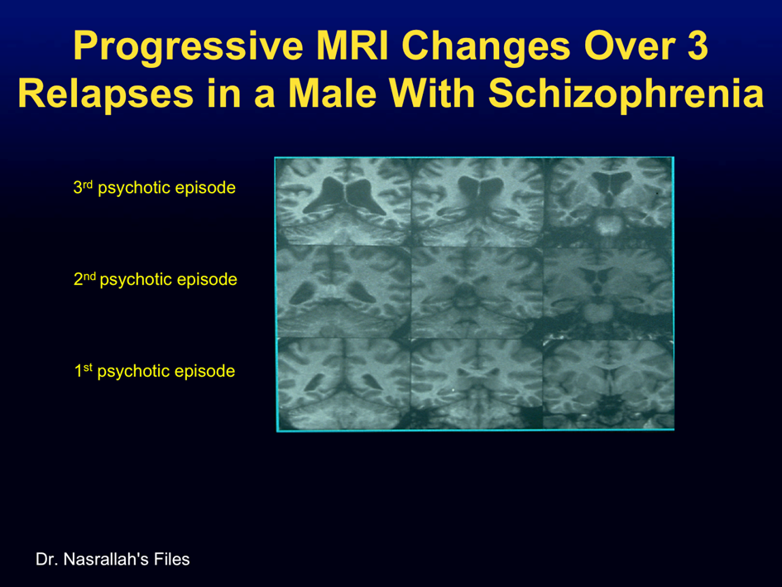

Slide 6
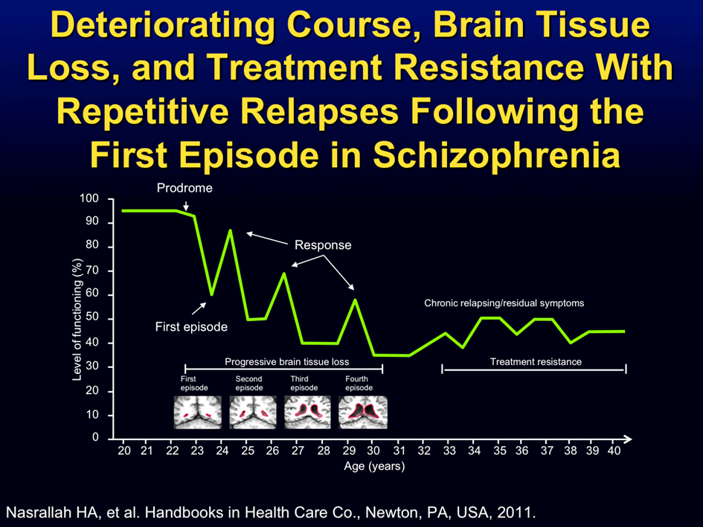

Slide 7
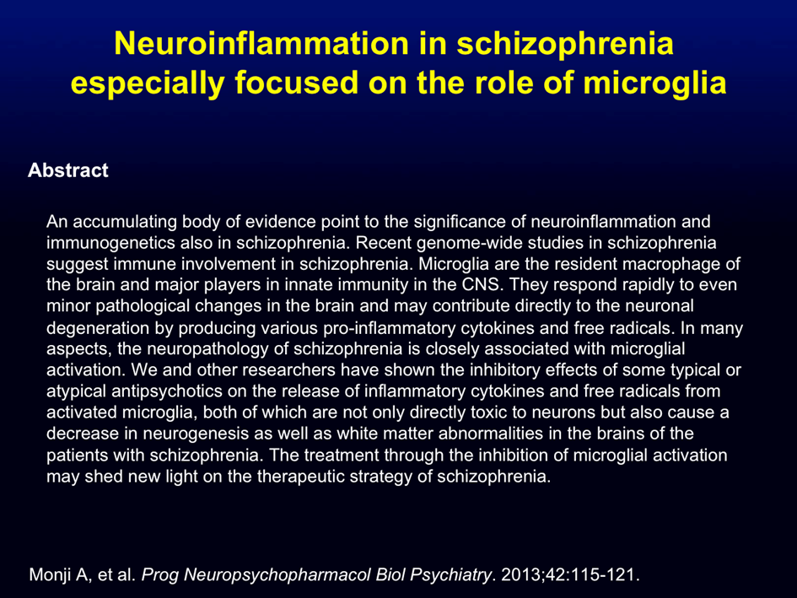

Slide 8
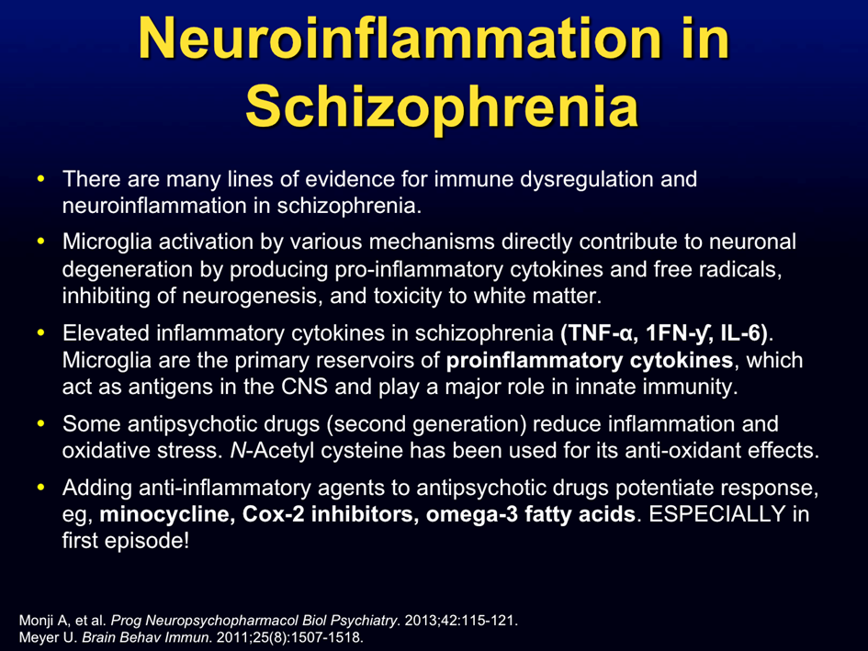

Slide 9
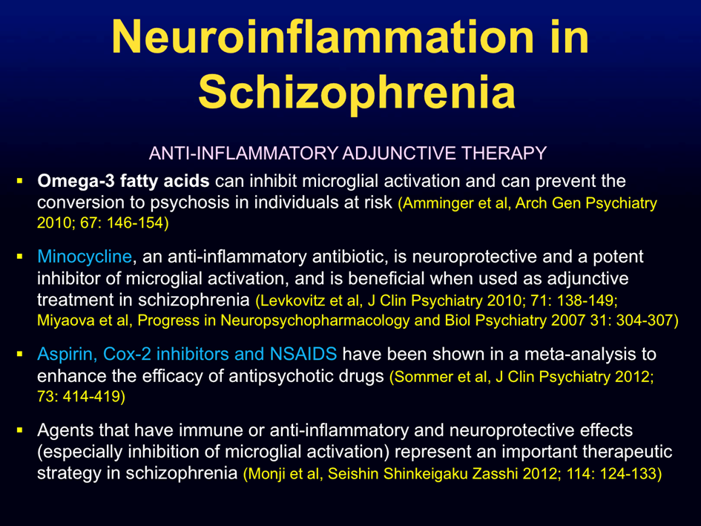

Slide 10
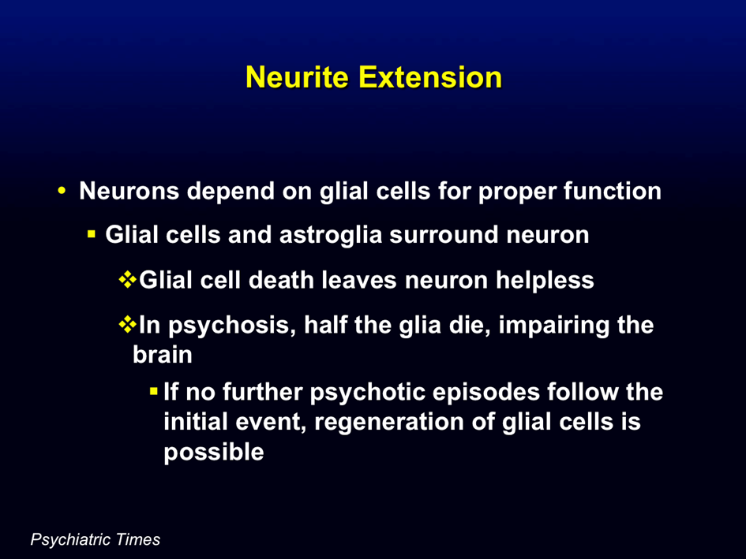

Slide 11
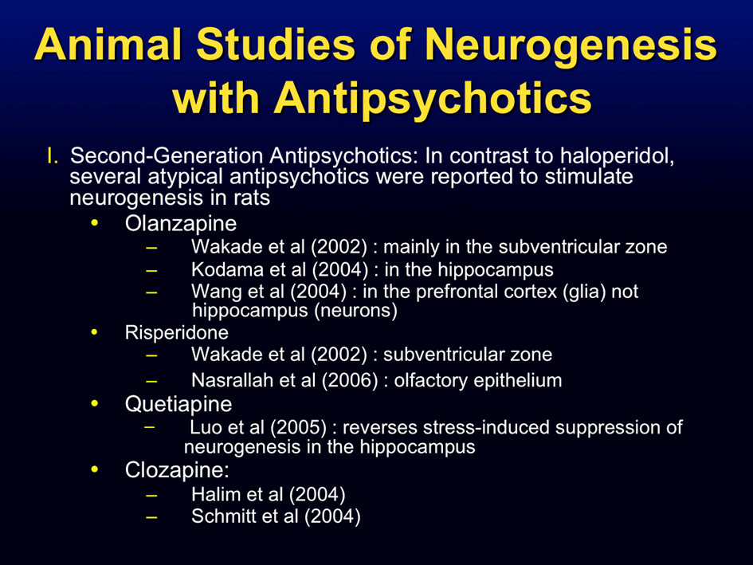

Slide 12
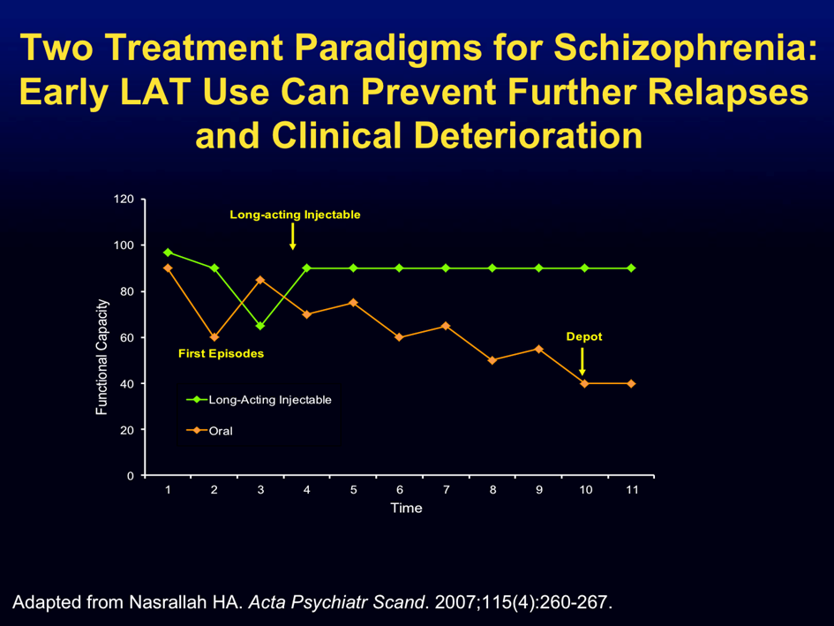

Slide 13
